Slide 1

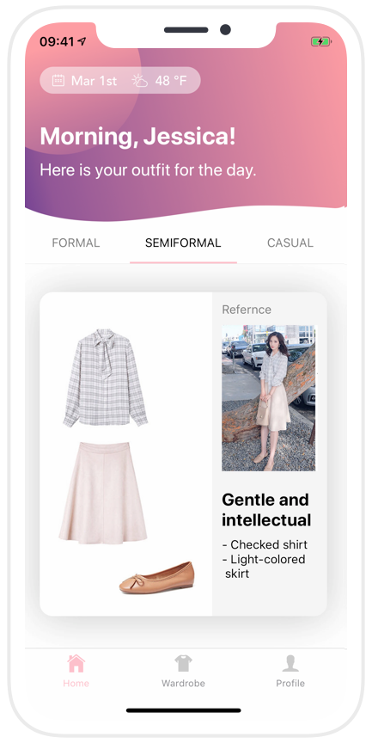

ProFashion
Your Personal Wardrobe Assistant
Kelly Zhao

Slide 2

Workday Morning
Spend 15-20 mins every morning choosing what to wear
Tries all combinations of clothes
Does not remember which clothes I’ve already worn.
Unsatisfied with my clothing combinations
Affect my performance when meeting clients
Notes:
Need to find don’t know how to dress up picture…
Picture: use woman with black hair
Jessica is typical of Asian professional women. We talked to more than CXX of them and here are some of thethings thewy rtold us

Slide 3
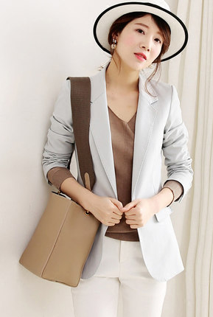

“
I am always in a rush in the morning, sometimes I don't want to take the effort to think about what to wear.
——Yan
Notes:
There are common patterns among young Asian Professional women：
Jessica is one of them...

Slide 4
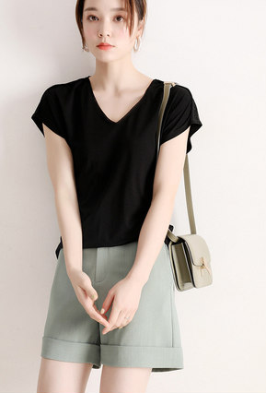

“
I want to leave a good impression on my colleagues and clients. I really need advice.
——Mya
Notes:
There are common patterns among young Asian Professional women：
Jessica is one of them...

Slide 5
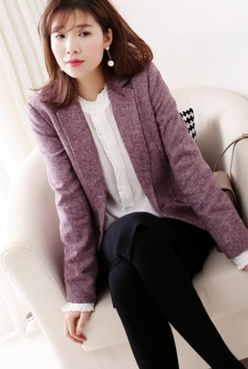

“
We work 1/3 of the time in our life, why not dress up well and look good?
—— Luca
Notes:
There are common patterns among young Asian Professional women：
Jessica is one of them...

Slide 6
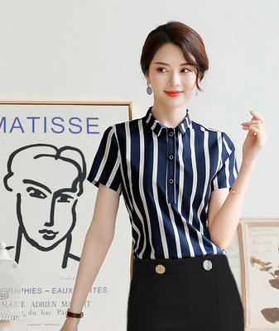

“
I wish I had an app that tell me what to wear every morning.
——Michelle
Notes:
There are common patterns among young Asian Professional women：
Jessica is one of them...

Slide 7

Women who value both beauty and their career
327 million total available market
40% need suggestion
65 items/yr purchased on average
Sources:
Worldometers / 200+ interviews / theatlas.com
Notes:
There is a huge market for people who value both beauty and career.
Our target customers are asian, professional women just like Jessica, who aged between 25 and 35. The total available market for this demographic is 327 million.
According to our customer interviews, about 40% of them are not satisfied with their current matching skills and feel the need for suggestions.
In addition, they purchase 65 items/yr on average, making mixing and matching an extremely hard and complex task.

Slide 8
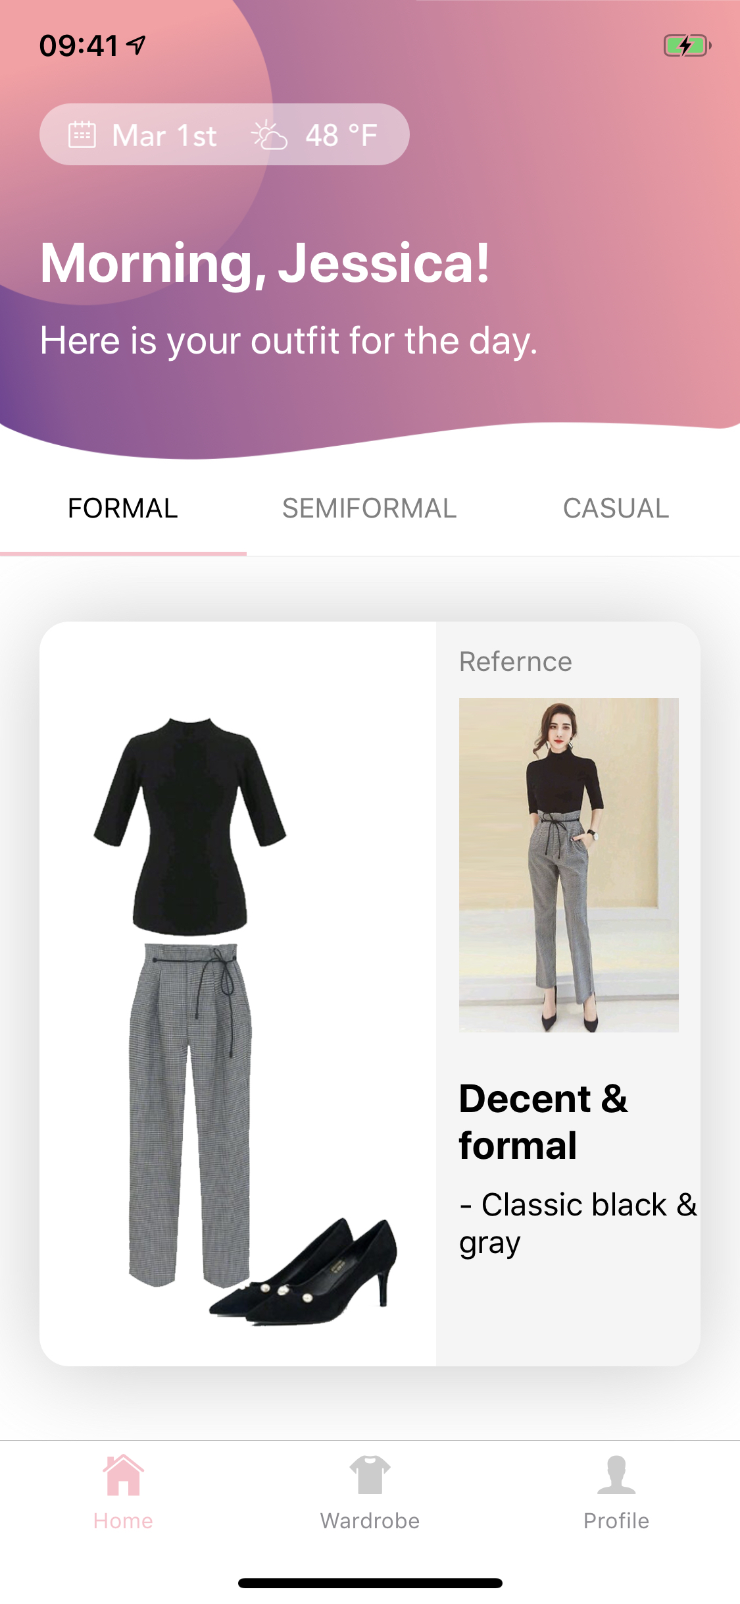
ProFashion
Solve the
Problem
0-click
Users’ clothes
Weather
Daily Schedule
ML
Solution

Slide 9
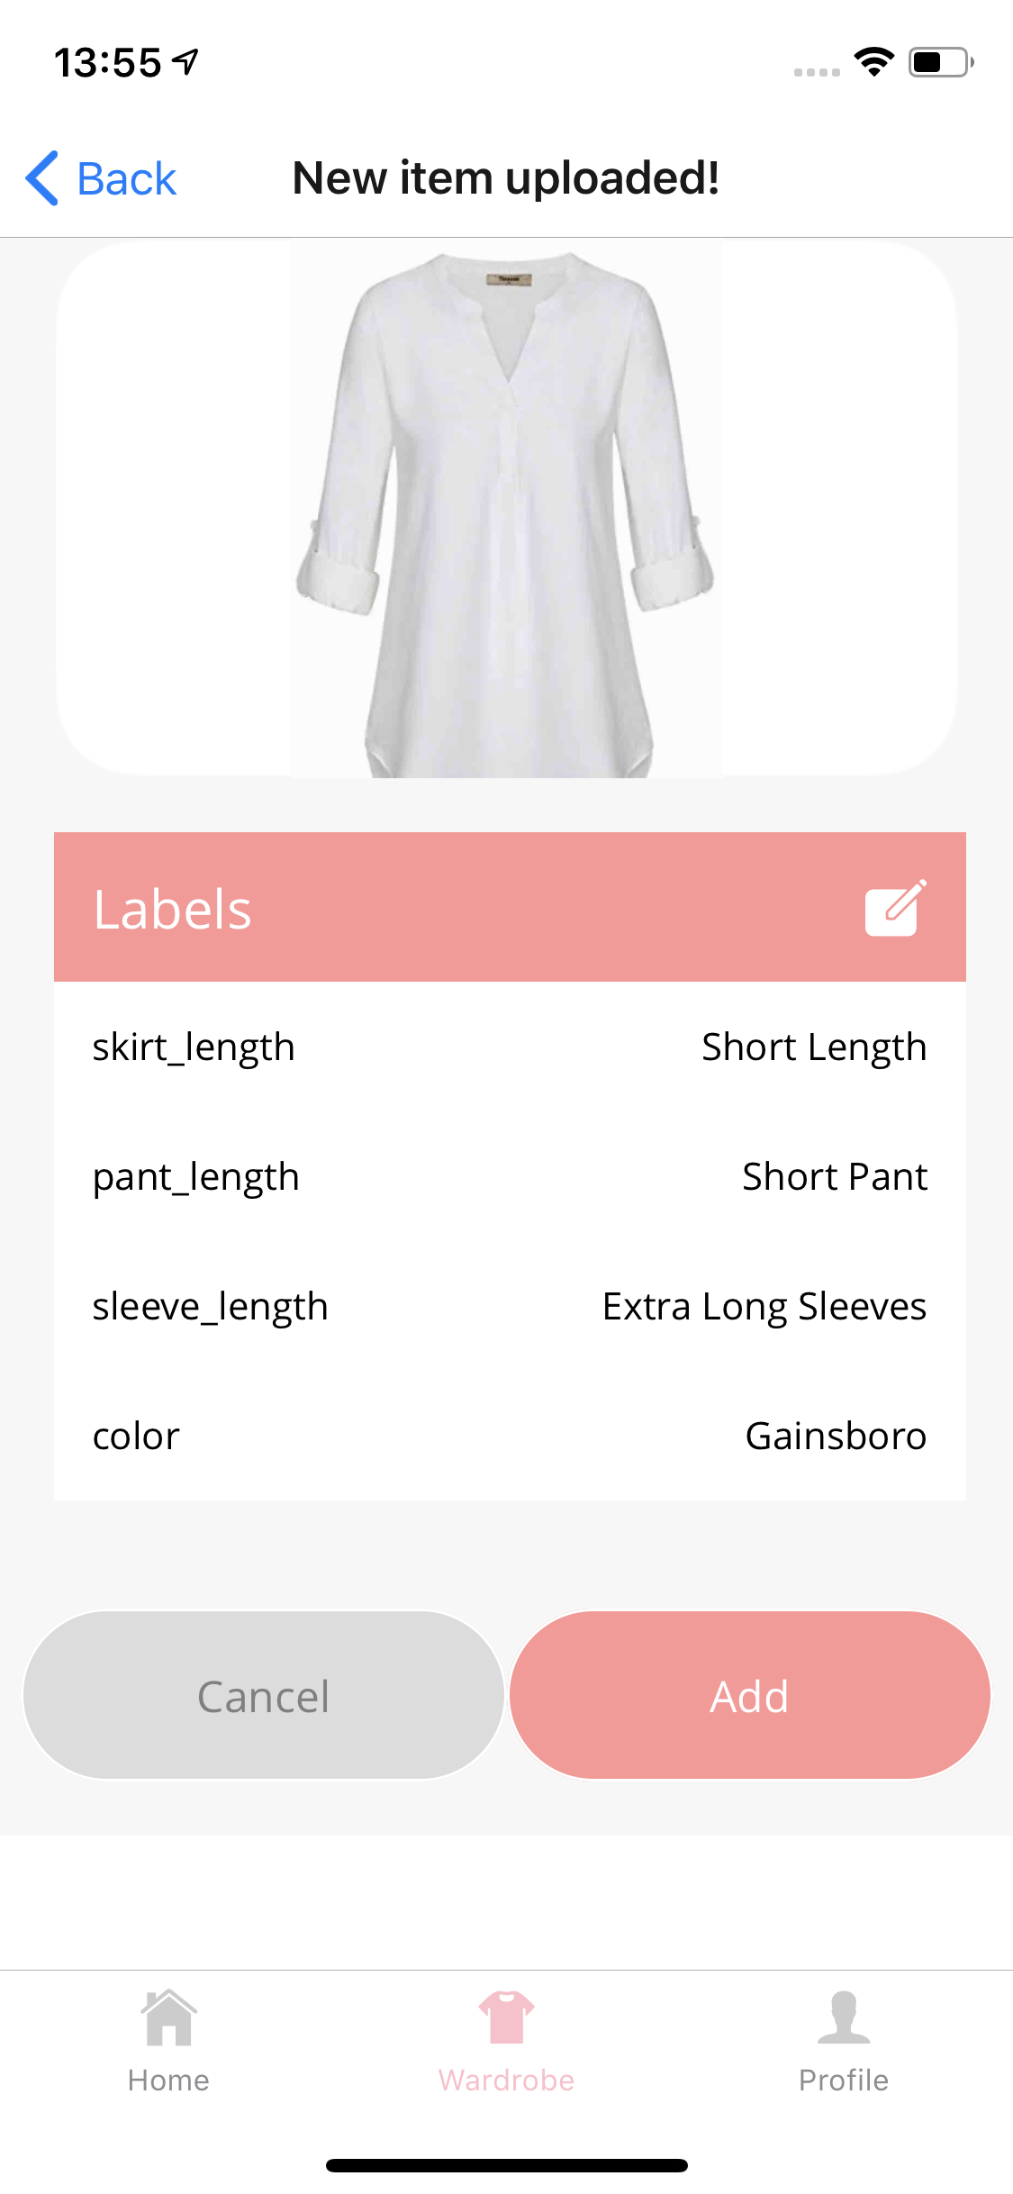
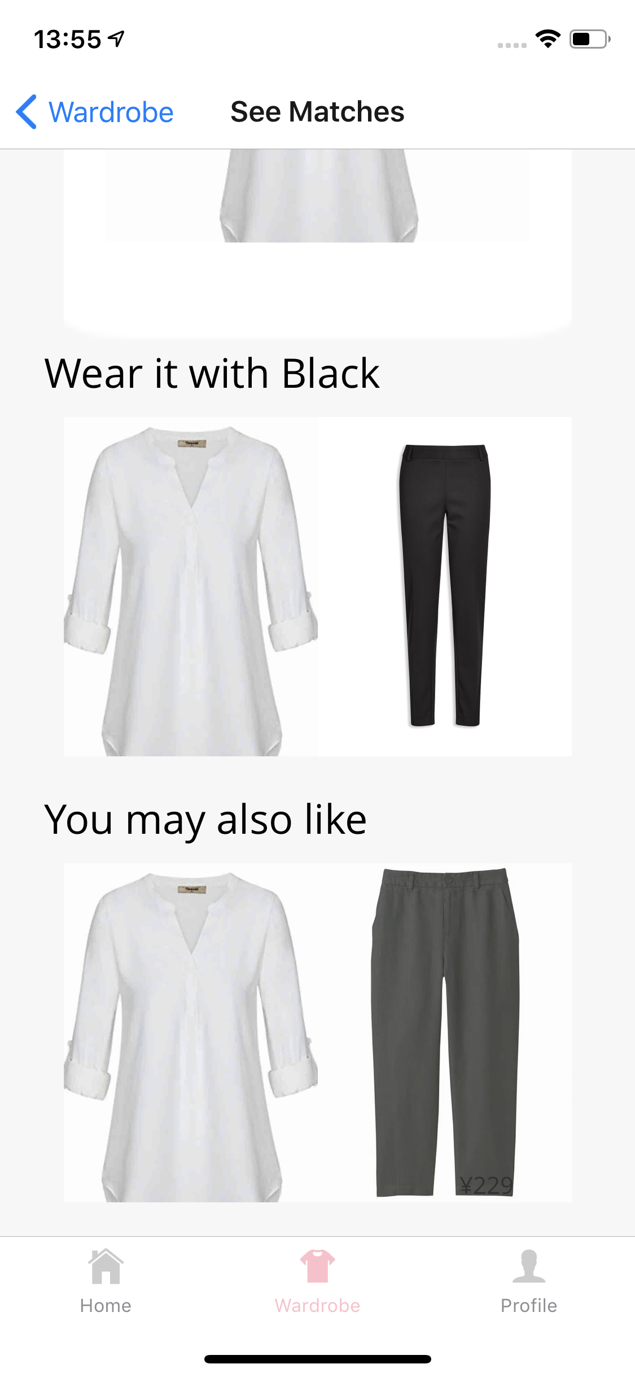
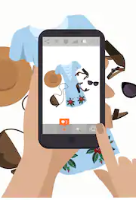
How it works
digitized wardrobe
Attribute recognition
Matching algorithm
Notes:
Let’s see how it works.
First, Jessica takes picture of all the professional clothes in her wardrobe and uploads it to the ProFashion app.
Then, our unique AI algorithm will automatically recognize the attributes of the items and generate a digitized wardrobe for her.
Finally the matching algorithm will pair her clothings and return the best combinations to her

Slide 10
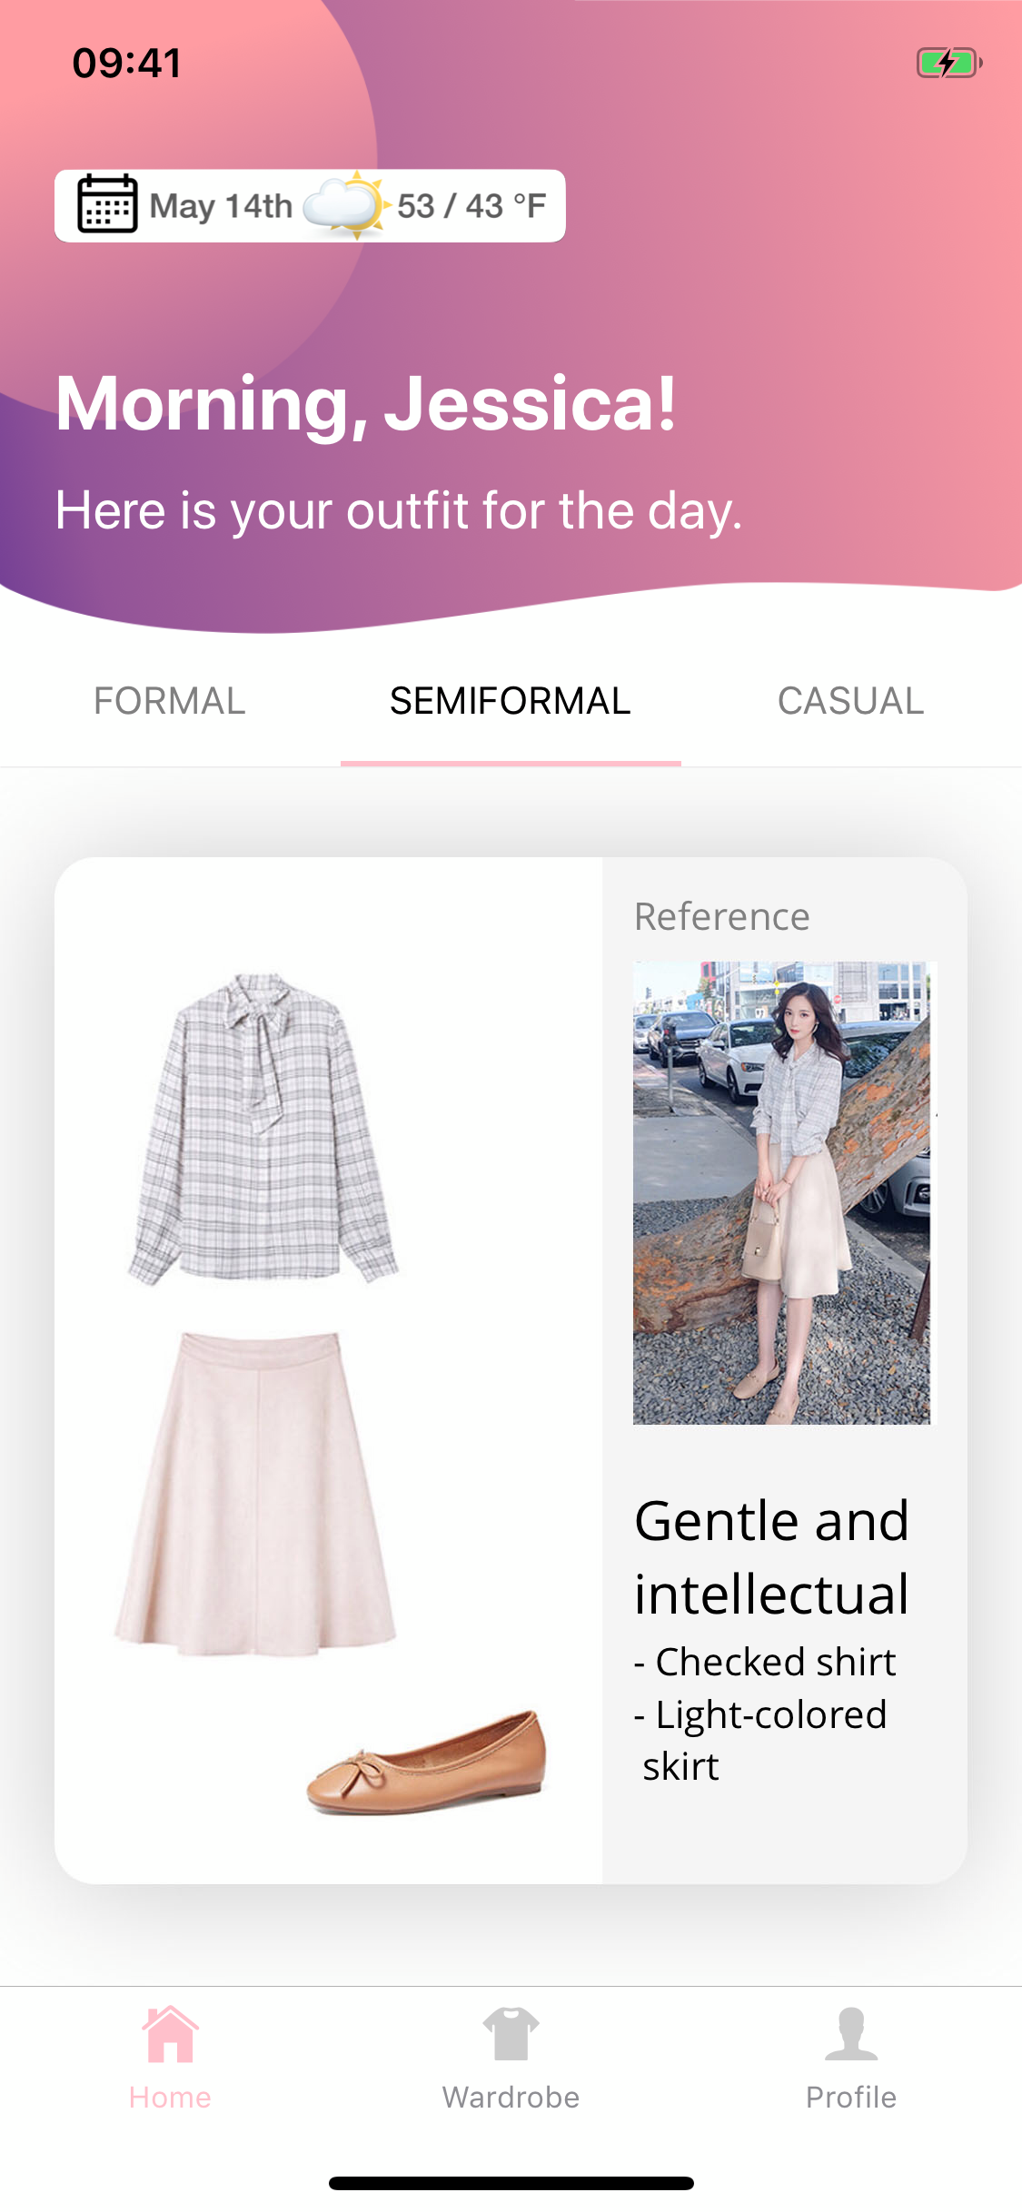
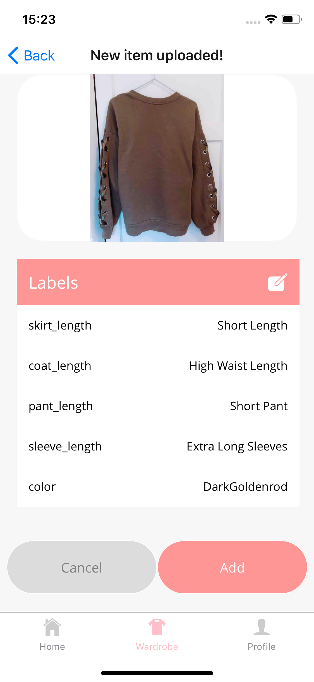
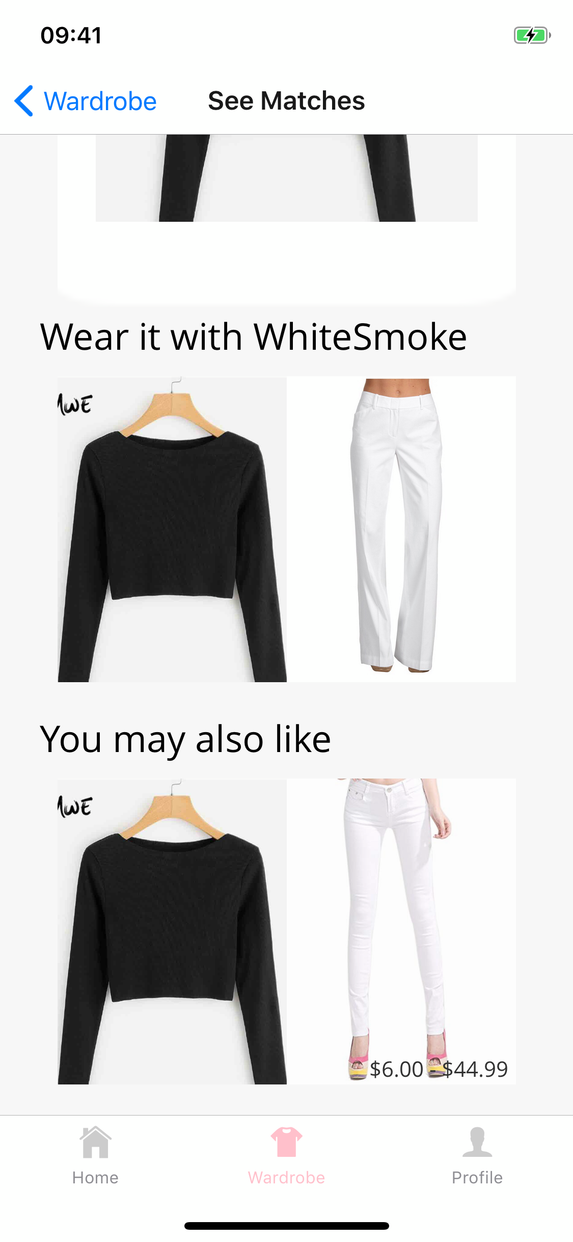
ProFashion is great, because:
3 different types of looks based on weather and occasion
Frees you from taking 10 mins a day wondering what to wear
Notes:
ProFashion is great, because:
you get 3 different types of looks everyday, based on weather and occasion.
It frees you from taking 10 mins a day wondering about what to wear or making matching mistakes,

Slide 11
ProFashion is great, because:
Generates tags using AI technology instead of manual input
Simple and easy upload process
Notes:
It generates tags using AI technology instead of manual input, making the uploading process as simple and easy.

Slide 12
ProFashion is great, because:
Try different styles that you never thought of before
Personalized purchase recommendations to help you shop smarter
Notes:
It enables you to try different styles that you never thought before
We also provide personalized purchase recommendations to help you shop smarter

Slide 13
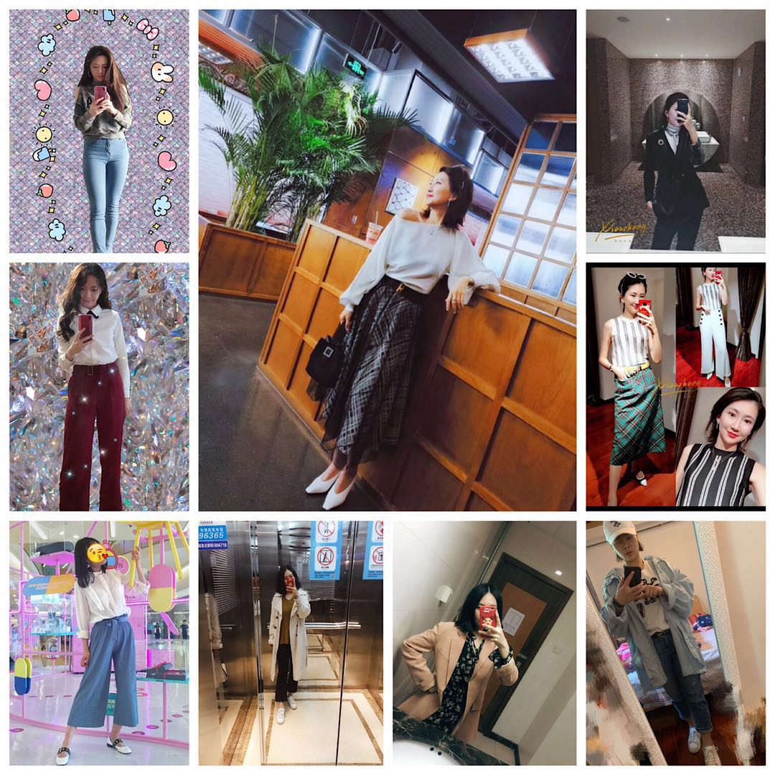
Our users love us
124 people in Wechat Group
25 beta testers
145 items uploaded
85% satisfaction rate on matching
Notes:
After we launched an advertising campaign through a wechat group, we gain 124 initial users actively posting their daily look in our Wechat group, without ever being asked, which is solid evidence that our target customer is very passionate about this problem.
We got 16 beta-testers for our MVP and saw 106 items uploaded in 2 days, 7 items per user on average.
We already have an 85% satisfaction rate for our matching algorithm, And we are still working to make it even better.
Next, Zi is going to talk about business model.

Slide 14
The Technology
Architecture
Attribute Recognition Algorithm
Color Detection
Mix & Match Algorithm

Slide 15



AI
Front end
Framework :
React-native
APP user interface for android and IOS
Server (Backend)
GPU on AWS
Services: Color/Design Labeling; Matching Rules
Data base
Fire base
User Info: User id/Use name/email/password...
Item under each User: item ID/item url/item image/item lable/...

Slide 16
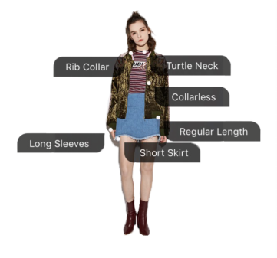
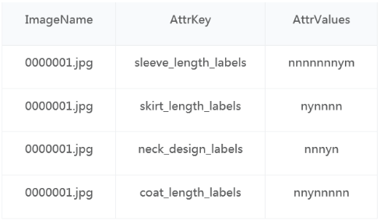
Attribute Recognition

Slide 17
Modeling
Data source
Ali FashionAI contest public dataset
200k labeled images
Modeling
Framework: Pytorch
Algorithm: CNN Resnet (widely used for image classification)
Outcome
8 attributes, 90M each
~90% Accuracy on test data set

Slide 18
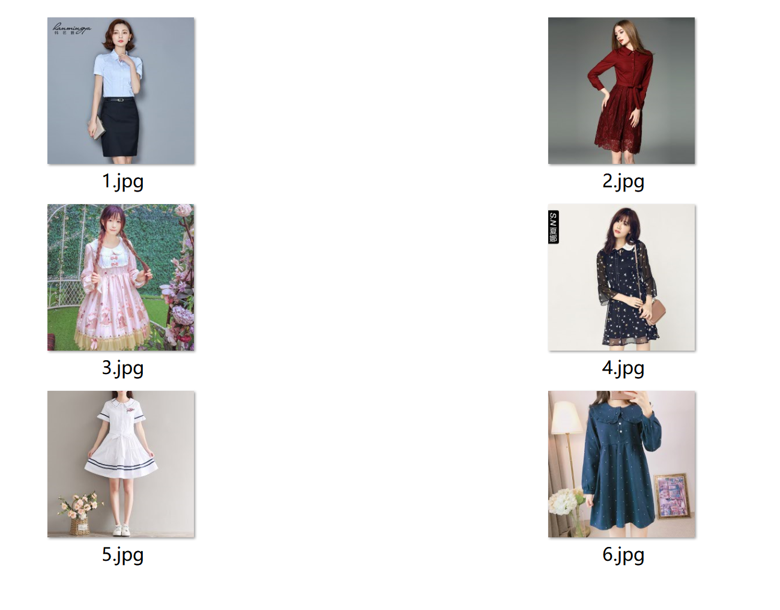
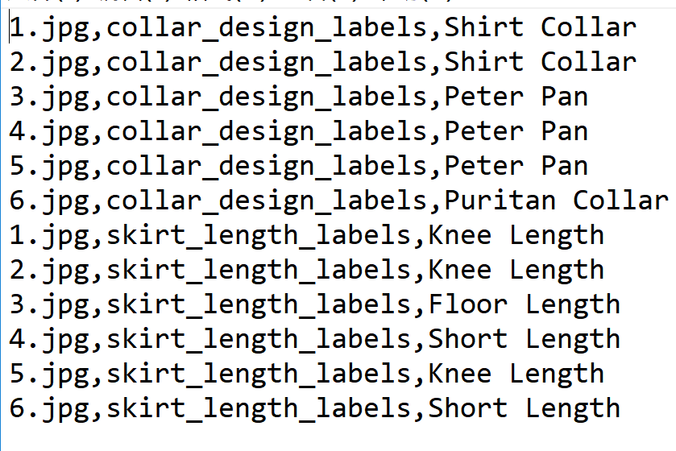
Sample outcome

Slide 19
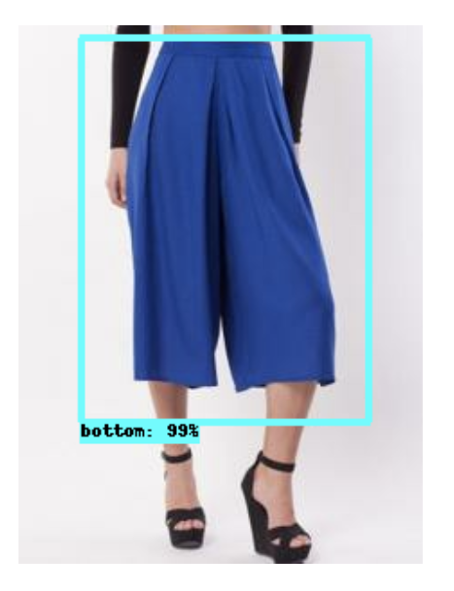
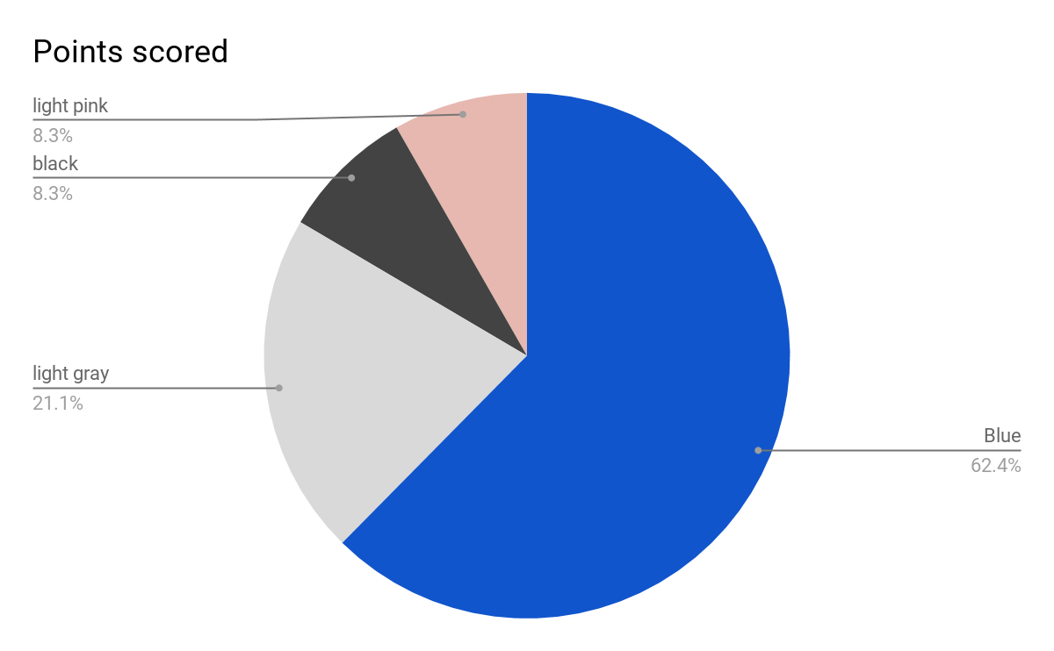
Color recognition
Object detection
Yolo (open source)
Find the major color
Kmeans clustering
Take the mean RGB of largest cluster

Slide 20
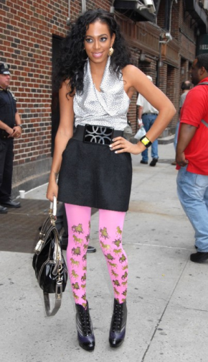
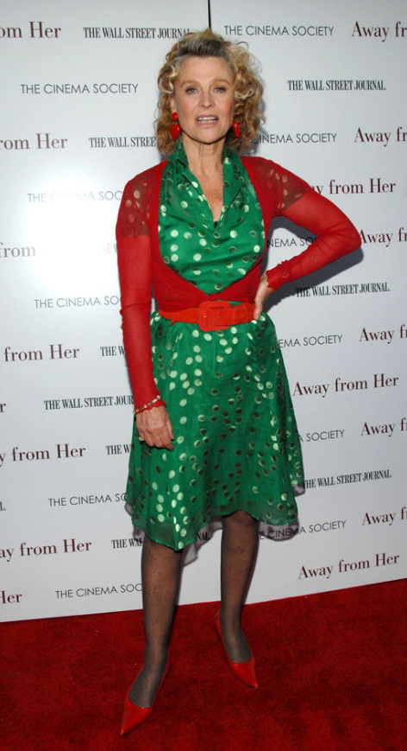
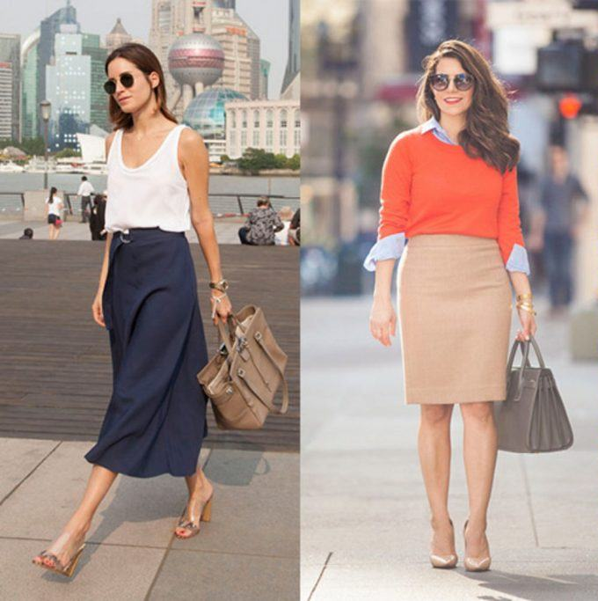
Matching Strategy
Descriptive knowledge
Interview customers and stylists
Color is most important; good matchings are...
VS

Slide 21
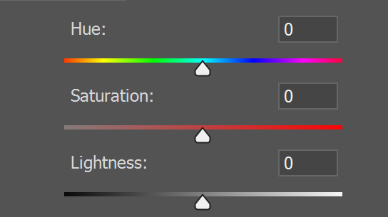
Matching Strategy
Convert description to KnowledgeBase
Color: RGB
Matching rule: HSV
Hard Rule: Matching Score =FH(H1-H2)+Fs(S1-S2)+Fv( V1-V2)
Other Rules: Coat Length - Temperature; Collar design - Occasion
Matching Score
|H1-H2|

Slide 22
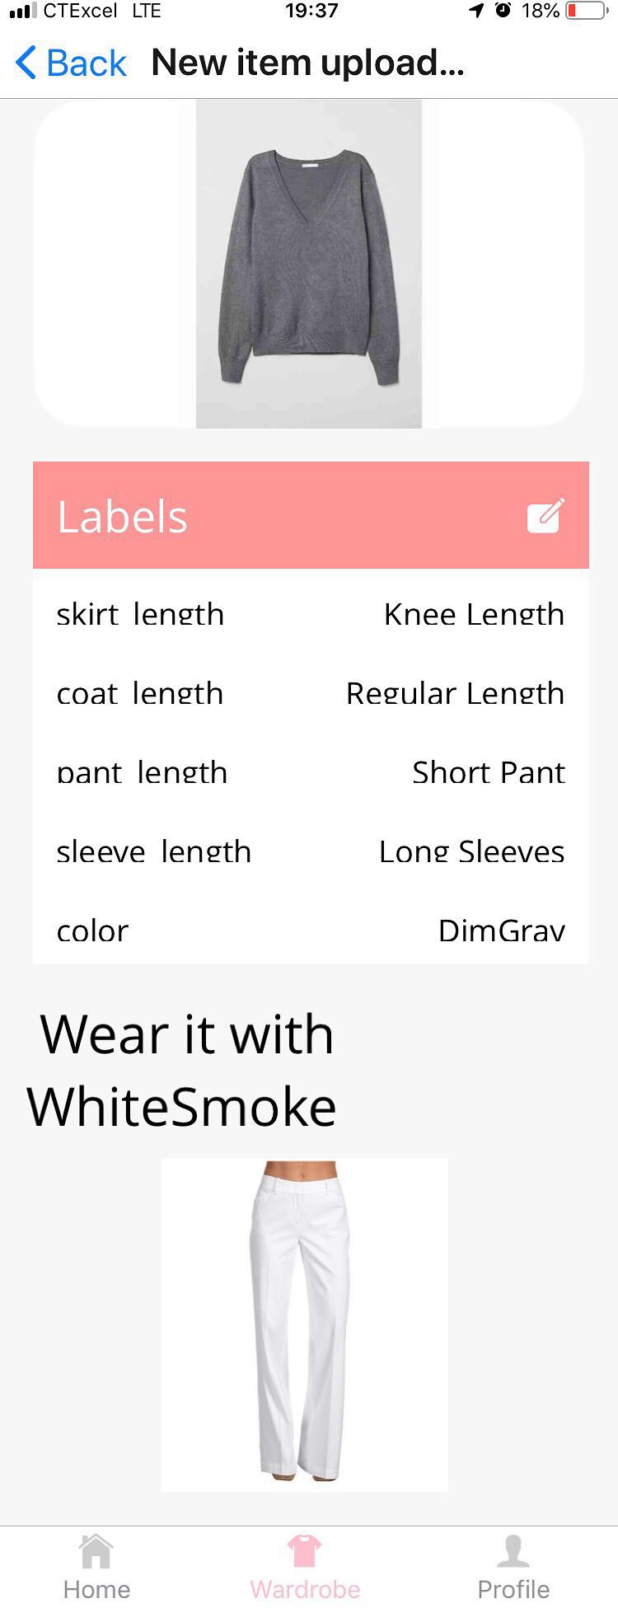
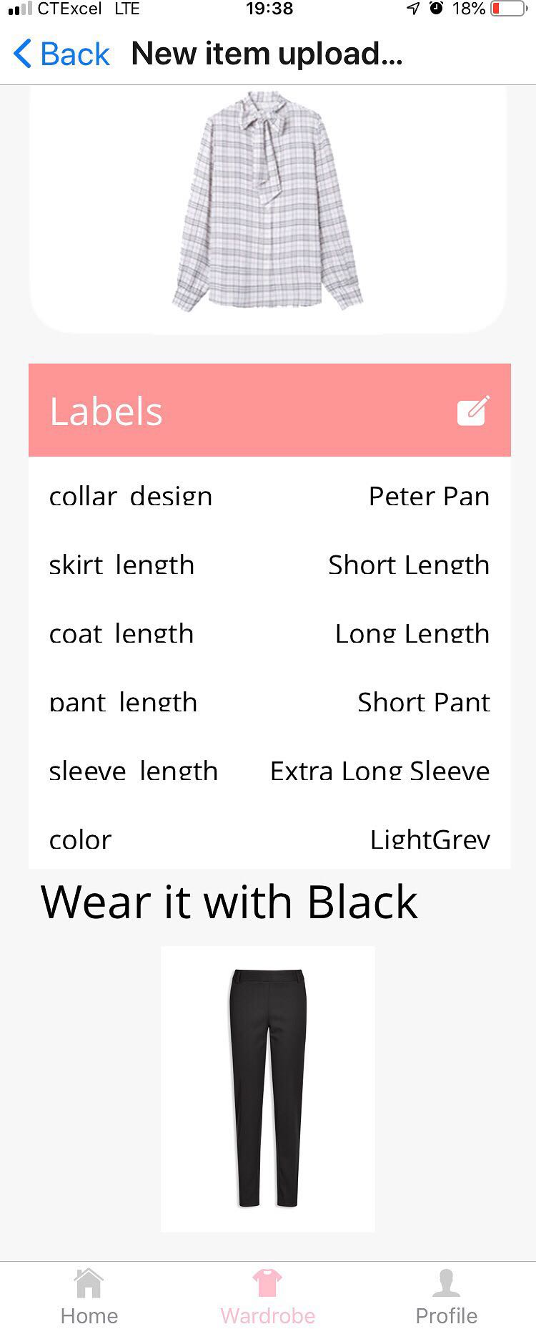
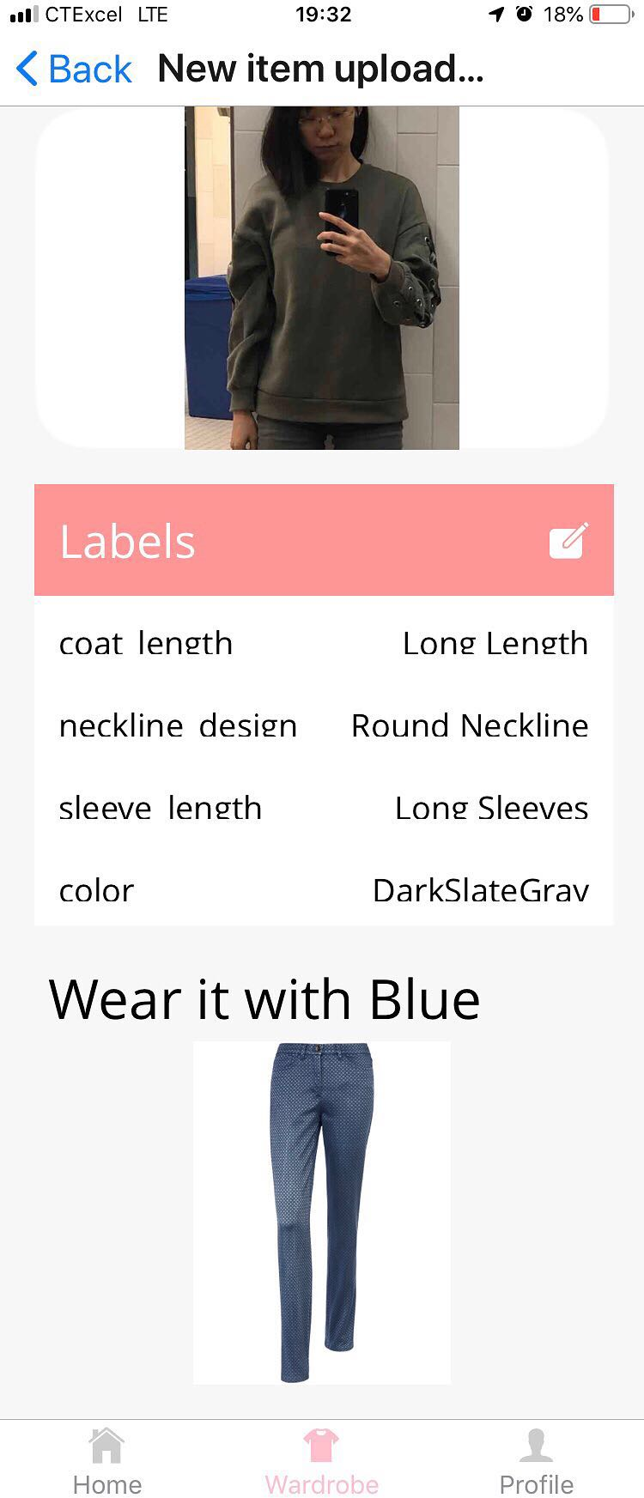
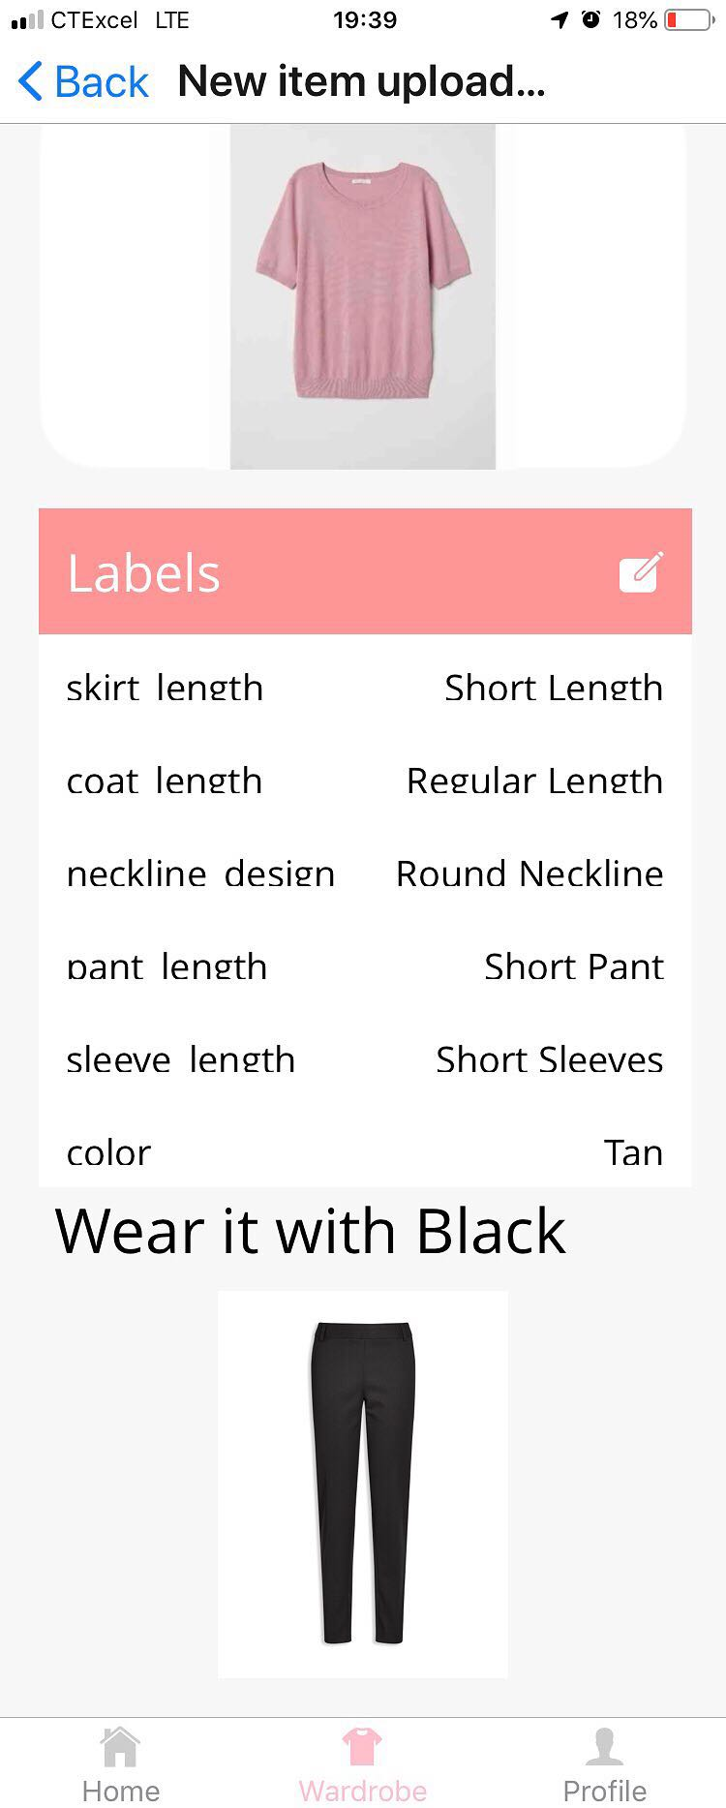

Slide 23

Thank You
Questions Welcomed

Slide 24
Appendix

Slide 25
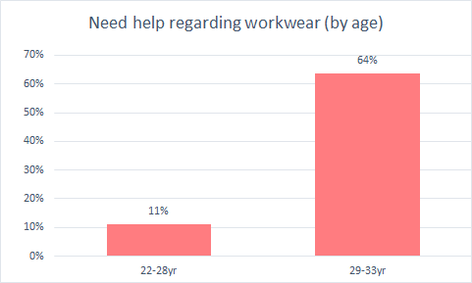
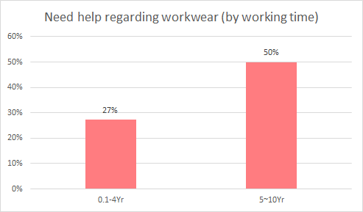
Key-Takeaway from Customer Interview
Women aged 29-33 are more likely feel the need of help with their workwear than women aged 22-28, 64% VS 11%
*According to 200+ customer interviews

Slide 26
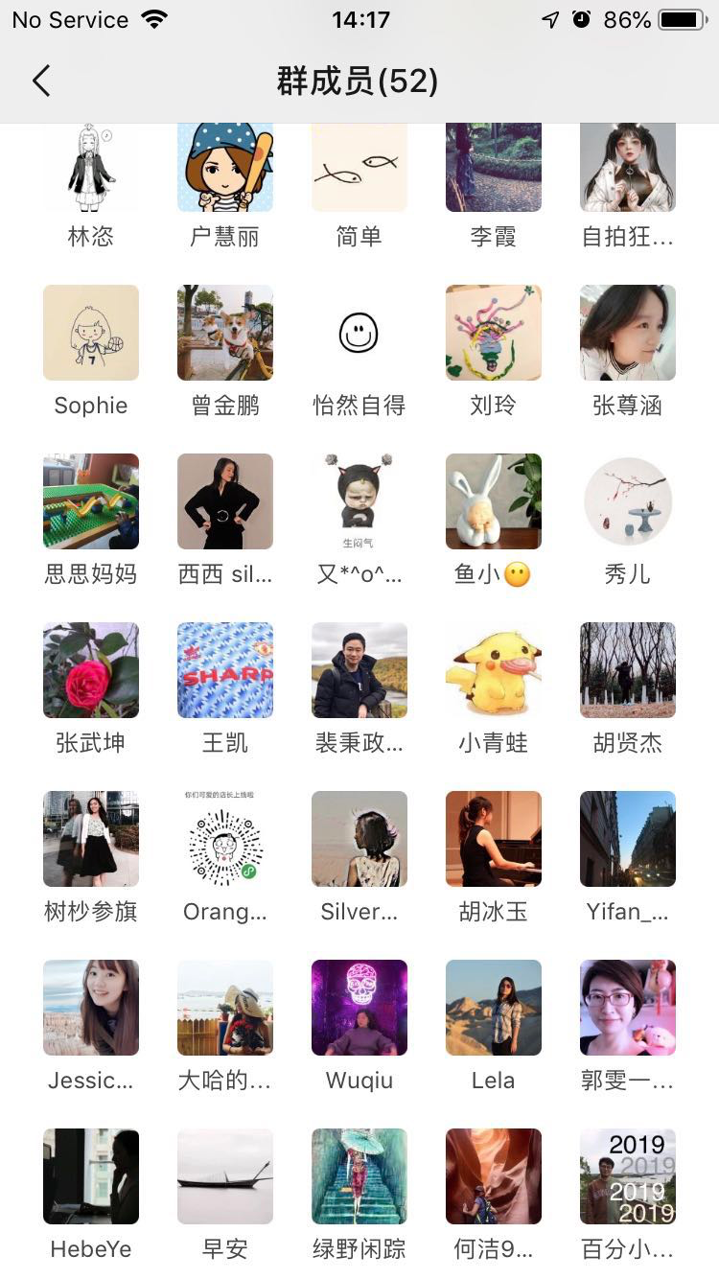
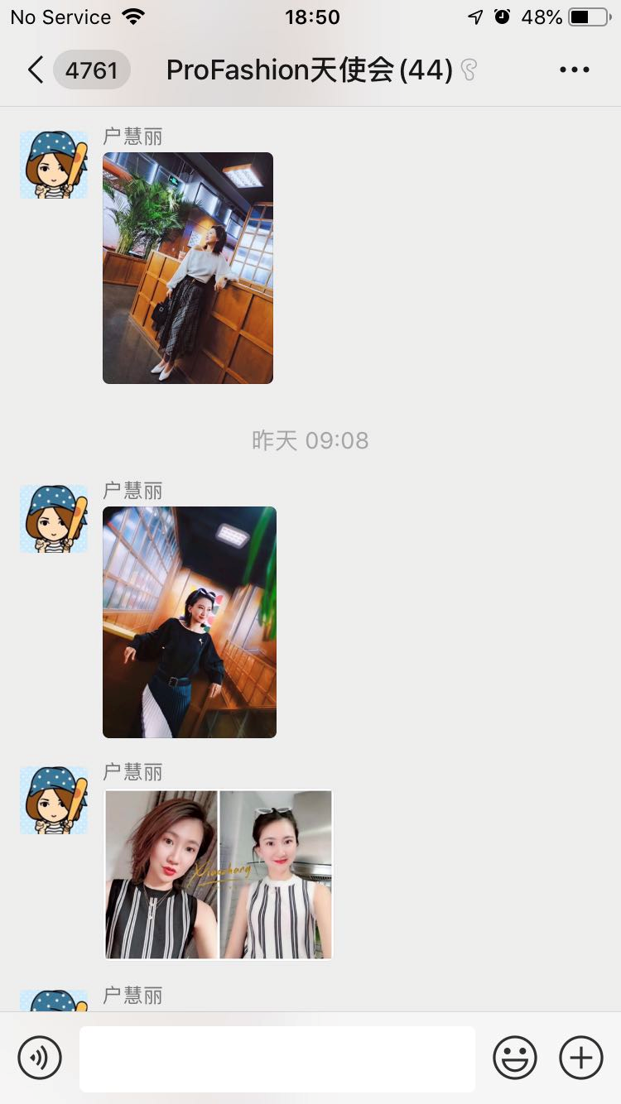
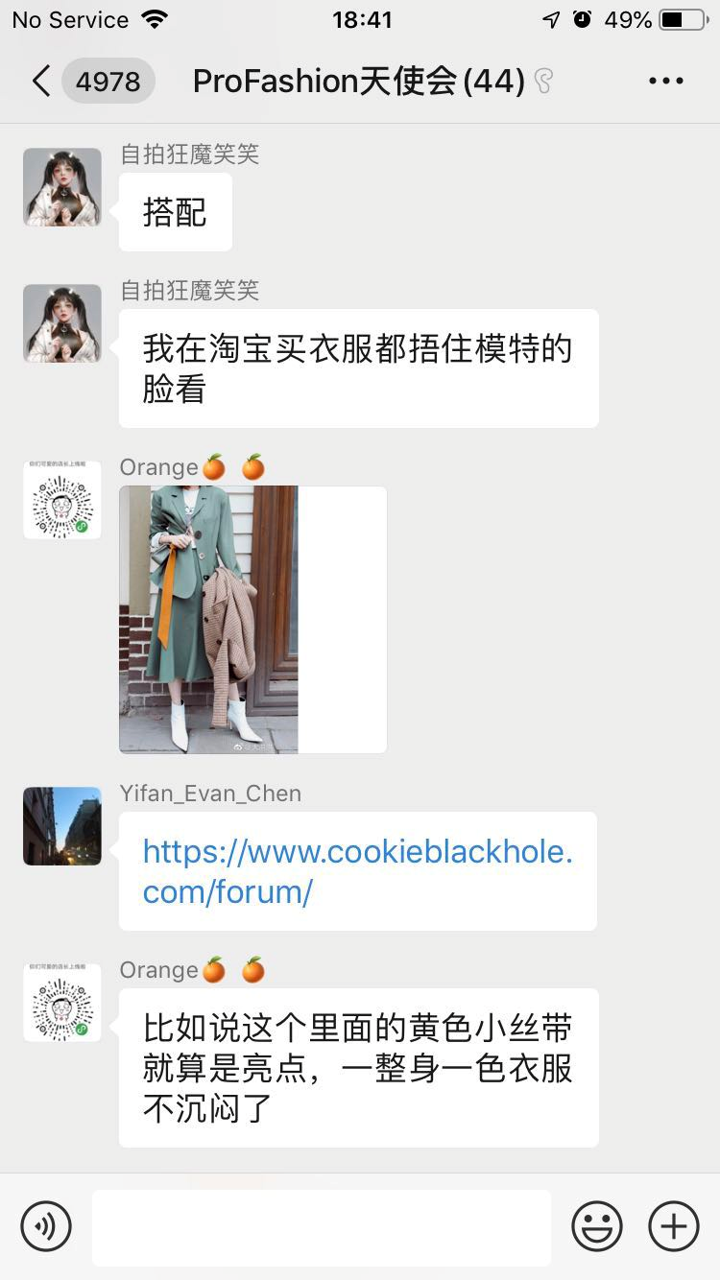
Angle Customers

Slide 27
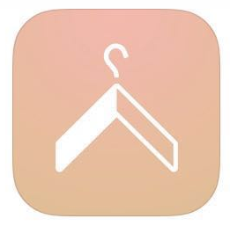
What makes us different?
VS
Cladwell
ProFashion
Women in the U.S.
Everyday Outfit
Manual
Customer
Occasion
Tagging
Asian Professionals
Workwear
Automatic
Notes:
What makes us different?
There are multiple APPs that are helping women dress up.
Most of them are focused on buying or renting new clothing, like Stitch fix and Rent the Runway.
Compared to our most direct competitor Cladwell, we are targeting at a more specific group with a stronger need, and a more specific scenario occurring at a higher frequency. Working professionals from Asia care more about their appearance and their workplace outfit, 5 days a week. [the data]
Our major competitive advantage is we tag the item automatically instead of letting users doing it manually, saving up to 50% of the time getting a wardrobe digitized, leading to a much better user experience.

Slide 28
Potential Business Model
Dummy Title
Dummy Title
Dummy Title
Subscription Fee
for premium features
Service Fee
for stylist consulting
Service Fee
for stylist consulting
White-label version for retailers
with other businesses
White-label version for retailers
with other businesses
Advertising
Contextually relevant
Advertising
Contextually relevant
Dummy Title
Dummy Title
Dummy Title
Dummy Title
Notes:
分成4页；每一页多一些信息
White-label version for retailers: more promising than data(only if you have data). Help customers shopping in store.

Slide 29
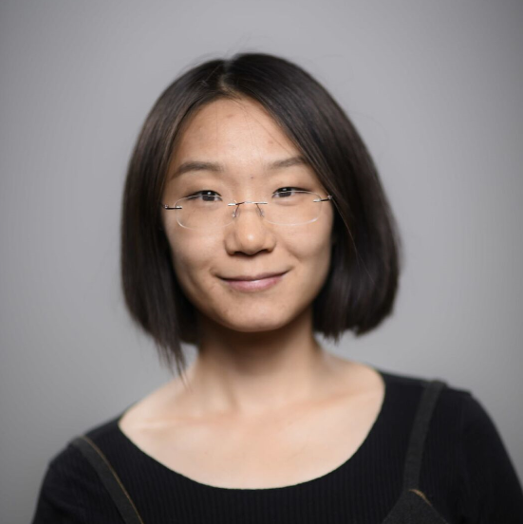


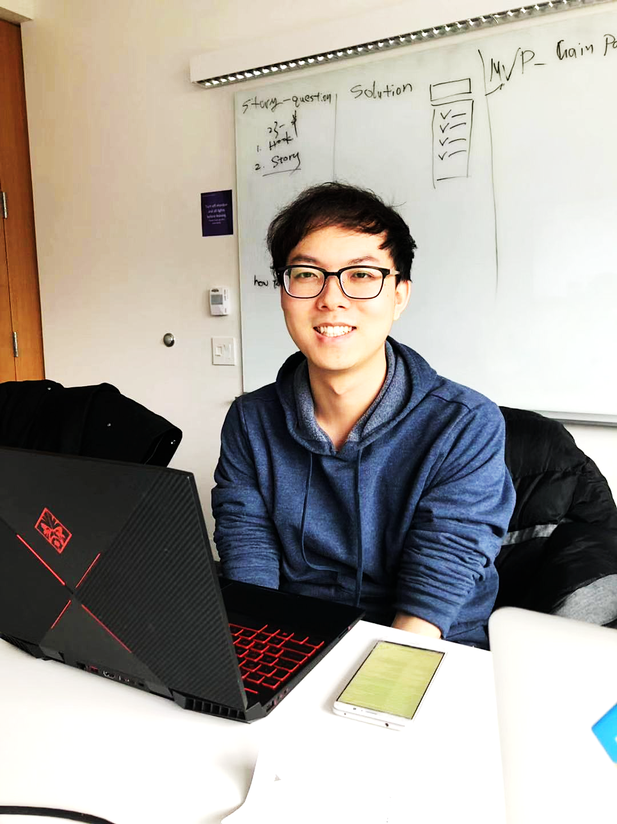
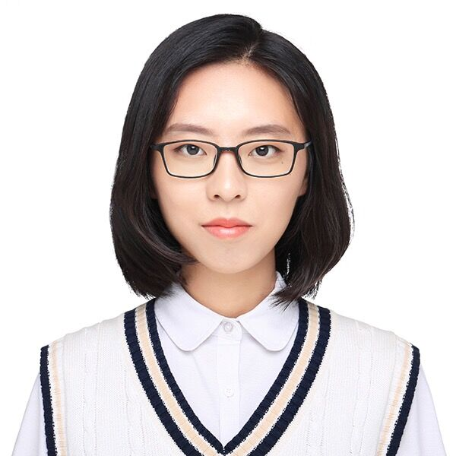

Most Importantly...
a well-rounded Team
Kelly Zhao
Siqi Chen
Wei Hang
Zi Lin
Chenghong Lin
Jiajia Guo
Technical PM
UI/UX
Front-end
AI Algorithm Engineer
Back End/ Algorithm
Marketing

